Slide 1

Skyscraper Information
Visualize data for important skyscrapers in Big Cities of USA
Angela Shi
12/12/2017

Slide 2
Basic Information for American High Buildings

Slide 4
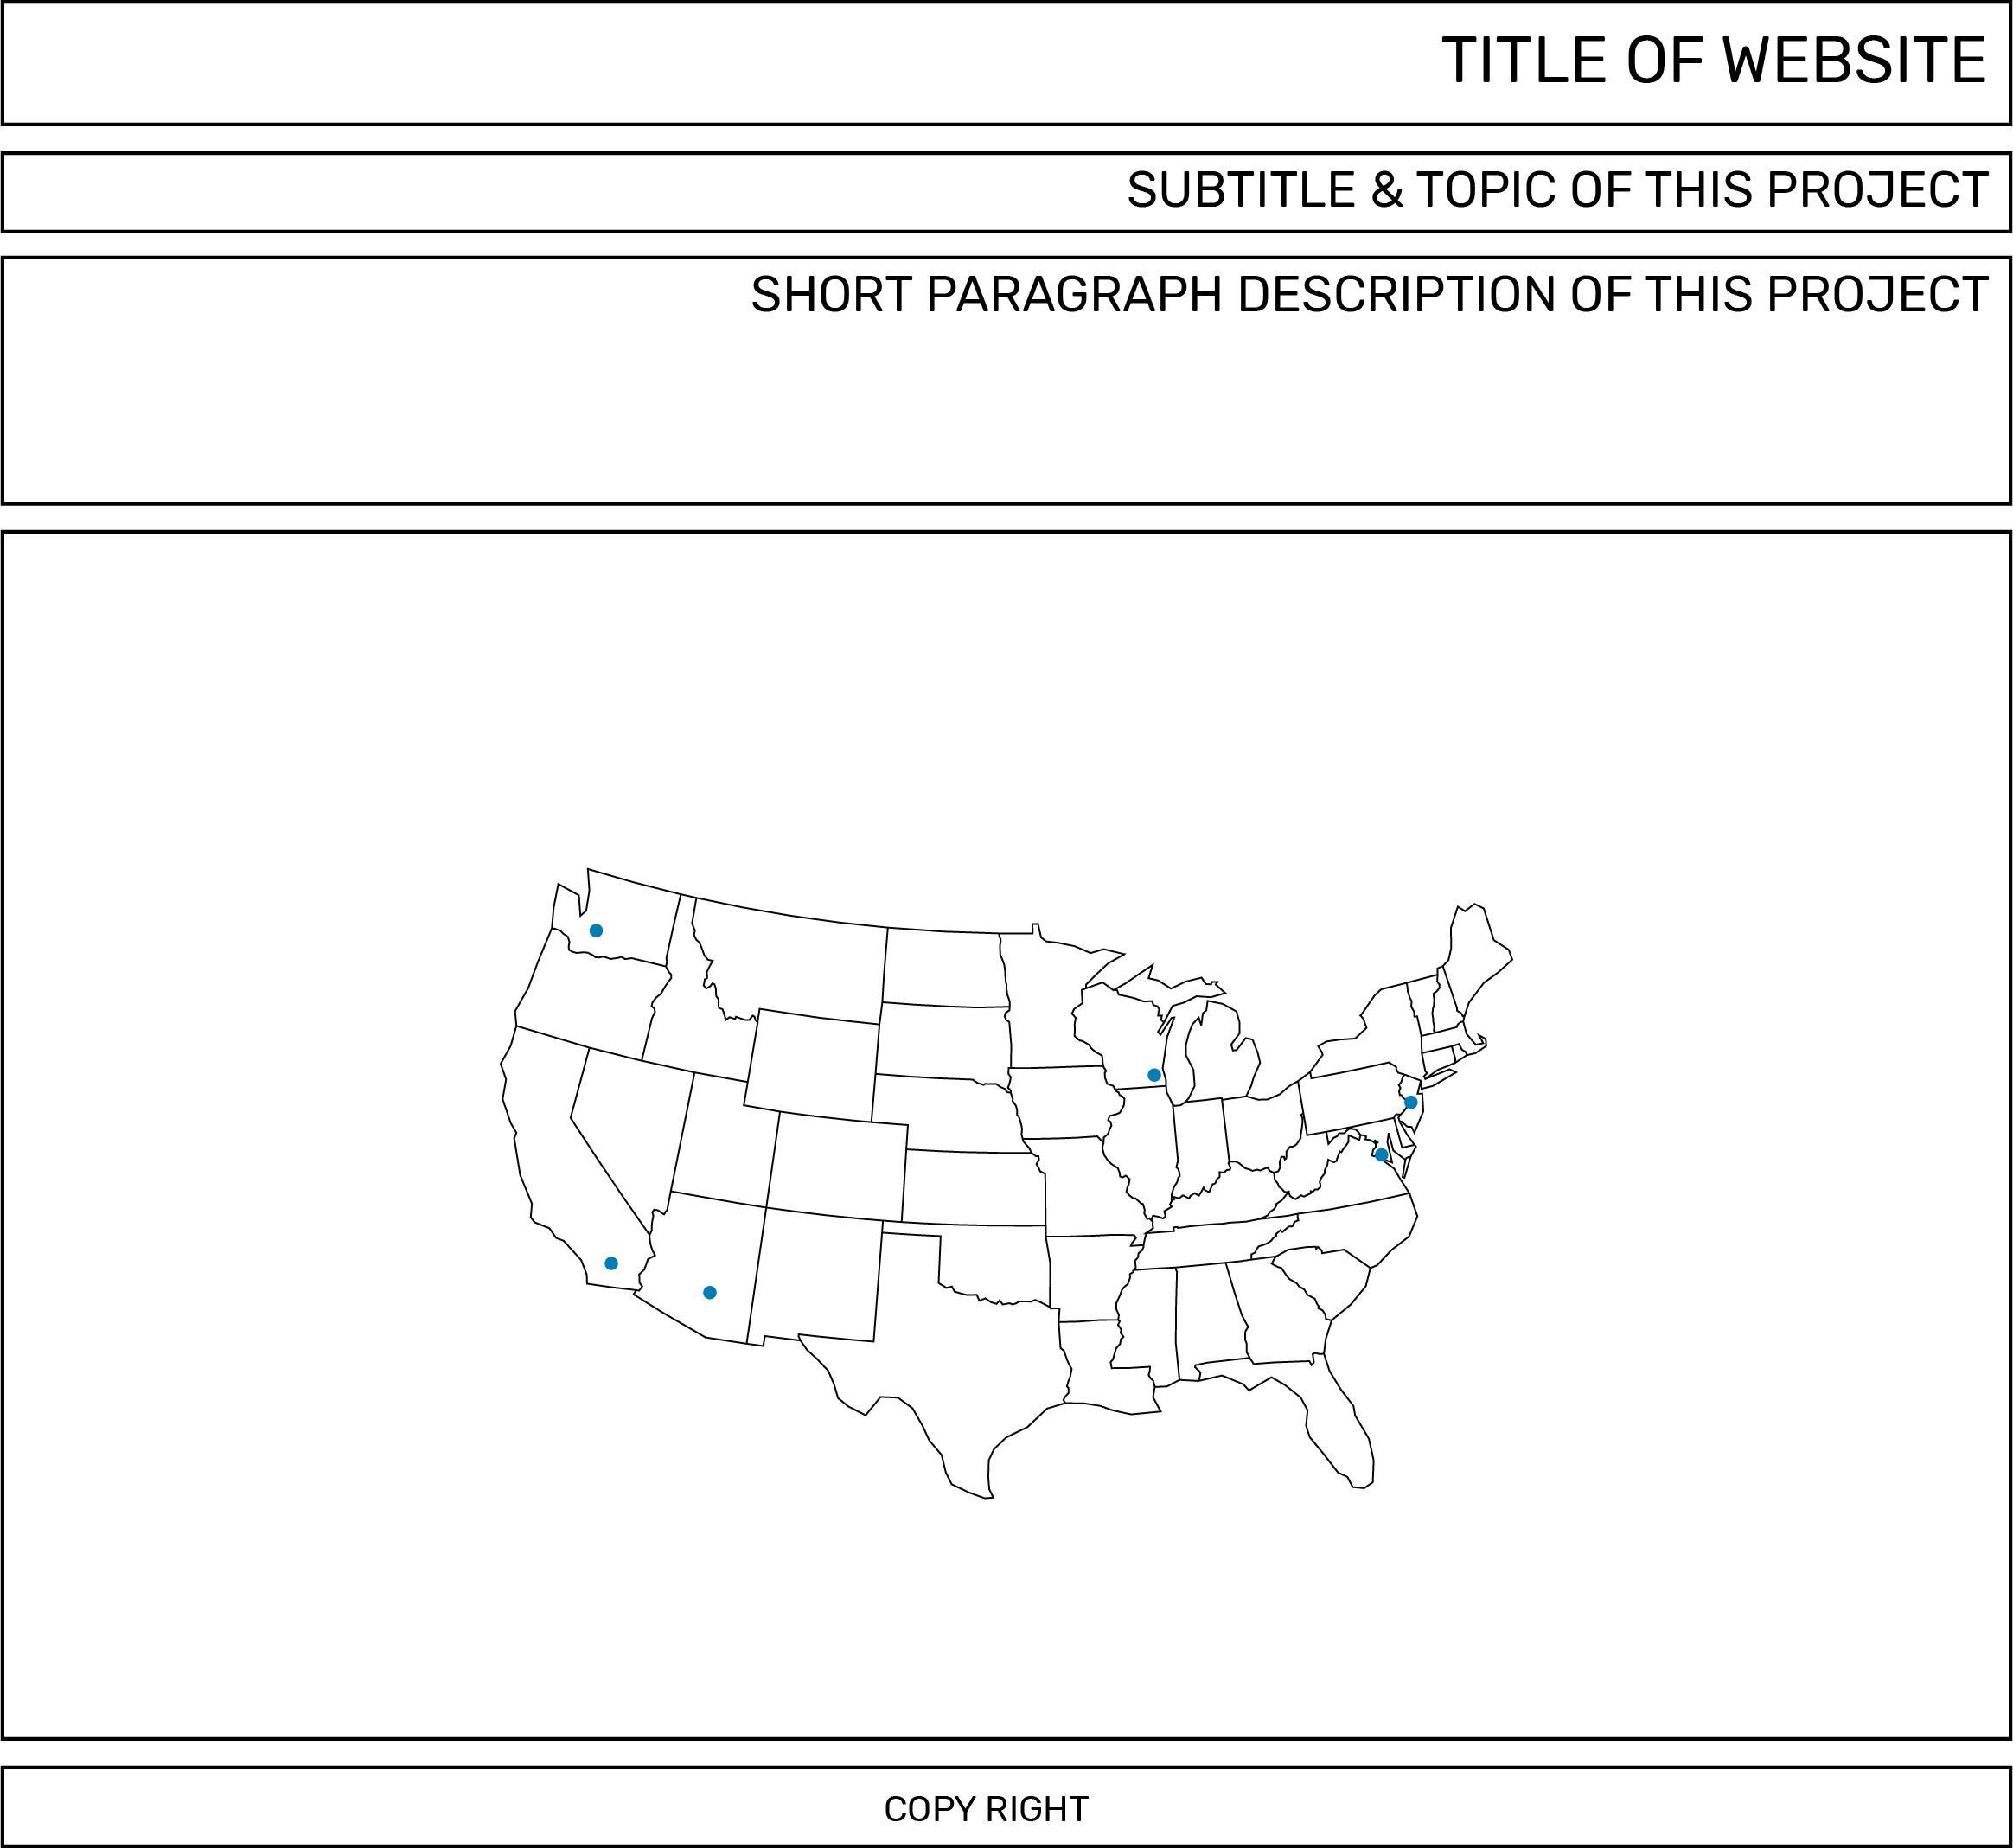
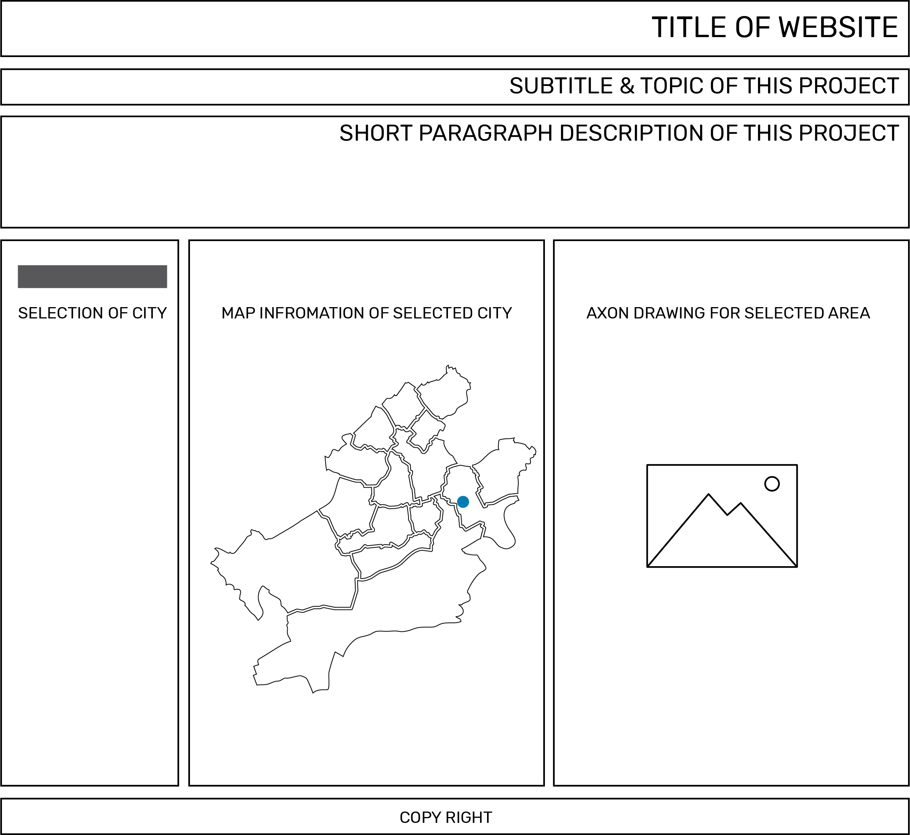
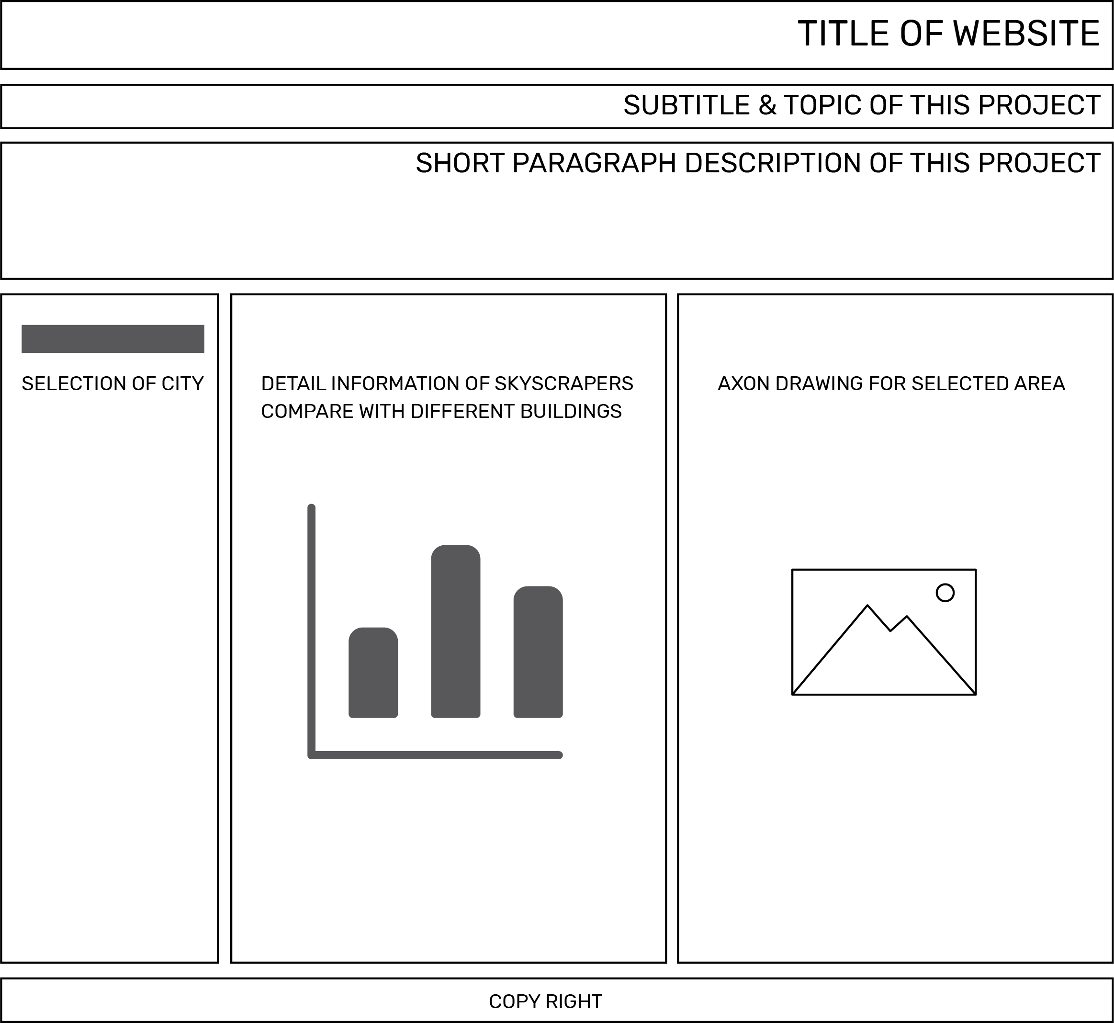
Interface of the Visual Website
Welcome page of the website
Select city and show the image of downtown
Compare data of the tallest buildings
Link address for the website

Slide 6
Situation and further possibility of the project
Now
Future
Structure of the project
Country
City
Area
Building
Functions of the project
Geo map information
Tooltip to show name of area
Zoom in function for area
Click dot to jump into building information
Tooltip for building information
Data Comparison
Structure of the project
Country
City -> more cities
Area -> more areas
Building -> more buildings
Functions of the project
Geo map information
Tooltip to show name of area
Zoom in function for area
Click dot to jump into building information-> more areas
Tooltip for building information
Tour path in the area
Data Comparison
Select compare buildings

